Slide 1
NUMBER‐BASE CONVERSIONS

Slide 2
Number Systems
A number system is defined as a system of writing for expressing numbers. It is the mathematical notation for representing numbers of a given set by using digits or other symbols in a consistent manner.
Decimal Number System
Uses 10 digits from 0 to 9= { 0, 1, 2, 3, …, 9 }
Example-35,64,135,2345 etc
Binary Number System
Uses two digits, 0 and 1.
Also called base 2 number system
Example-100,011,101,1100,10 etc
2

Slide 3
Number Systems
Octal Number System:
Uses eight digits, 0,1,2,3,4,5,6,7.
Also called base 8 number system
Example-35,64 ,71,135 etc
Hexadecimal Number System:
Uses 10 digits and 6 letters, 0,1,2,3,4,5,6,7,8,9,A,B,C,D,E,F.
Letters represents numbers starting from 10.
A = 10, B = 11, C = 12, D = 13, E = 14, F = 15.
Also called base 16 number system.
Example-135,782,18D,6FC etc
3

Slide 4
Decimal Number System
Decimal number system, symbols = { 0, 1, 2, 3, …, 9 }
Example:(7594)₁₀ = (7x10³) + (5x10²) + (9x10¹) + (4x10⁰)
A decimal number such as 7,594 represents a quantity equal to 7 thousands, plus 5 hundreds, plus 9 tens, plus 4 units. The thousands, hundreds, etc., are powers of 10 implied by the position of the coefficients (symbols) in the number.
In general, (a_{n}a_{n-1}… a₀)₁₀ = (a_{n} x 10^{n}) + (a_{n-1} x 10^{n-1}) + … + (a₀ x 10⁰)
(2.75)₁₀ = (2 x 10⁰) + (7 x 10⁻¹) + (5 x 10⁻²)
In general, (a_{n}a_{n-1}… a₀ . f₁f₂ … f_{m})₁₀ = (a_{n} x 10^{n}) + (a_{n-1}x10^{n-1}) + … + (a₀ x 10⁰) + (f₁ x 10⁻¹) + (f₂ x 10⁻²) + … + (f_{m} x 10^{-m})

Slide 5
NUMBER‐BASE CONVERSIONS
Representations of a number in a different radix are said to be equivalent if they have the same decimal representation. For example, (0011)₈ and (1001)₂ are equivalent—both have decimal value 9.
The conversion of a number in base r to decimal is done by expanding the number in a power series and adding all the terms as shown previously.
We now present a general procedure for the reverse operation of converting a decimal number to a number in base r.
If the number includes a radix point, it is necessary to separate the number into an integer part and a fraction part, since each part must be converted differently.
The conversion of a decimal integer to a number in base r is done by dividing the number and all successive quotients by r and accumulating the remainders.

Slide 6
Conversion between Decimal and other Bases
Decimal to base-R
whole numbers: repeated division-by-R
fractions: repeated multiplication-by-R
Base-2 Base-2
Base-8 Base-8
Base-16 Decimal Base-16
… ….
Base-R Base-R
6

Slide 7
Decimal-to-Binary Conversion
Repeated Division-by-2 Method (for whole numbers)
Repeated Multiplication-by-2 Method (for fractions)
7

Slide 8
Repeated Division-by-2 Method
To convert a whole number to binary, use successive division by 2 until the quotient is 0. The remainders form the answer, with the first remainder as the least significant bit (LSB) and the last as the most significant bit (MSB).
(43)₁₀ = (101011)₂
8

Slide 9
Decimal to Binary Conversion
Divide by 2 Process
Decimal #
13 ÷ 2 = 6 remainder 1
6 ÷ 2 = 3 remainder 0
3 ÷ 2 = 1 remainder 1
Divide-by-2 Process
Stops When
Quotient Reaches 0
1 ÷ 2 = 0 remainder 1
1
1
0
1
9

Slide 10
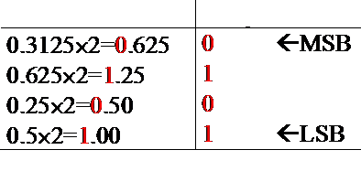
Repeated Multiplication-by-2 Method
To convert decimal fractions to binary, repeated multiplication by 2 is used. The process is continued until the fraction becomes 0 or until the number of digits has sufficient accuracy.
The coefficients of the binary number are obtained from the integers as follows: The first integer is written as the MSB, and the last as the LSB.
(0.3125)₁₀ = (.0101)₂
Coefficient
10

Slide 11

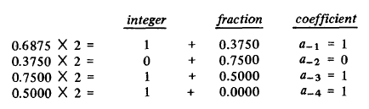

Decimal-to-Binary Conversion
Convert
to Binary

Slide 12
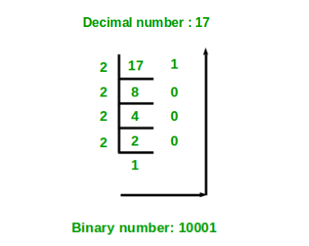
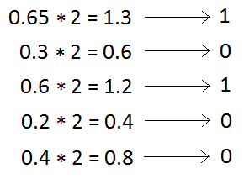
Decimal to Binary Conversion of 17.65
(17.65)10 = (10001.10100)2

Slide 13
Practice
Convert the following decimal numbers into binary:
Decimal (11)10 =(1011)2
Decimal (4)10 = (0100)2
Decimal (17)10 = (10001)2
13

Slide 14
Binary to Decimal Conversion

Slide 15
Place Value
Example - Place value in binary system:
2³
2²
2¹
2⁰
Place Value
8
4
2
1
Binary Number
1
1
0
0
RESULT: (1100)₂ = decimal 8 + 4 + 0 + 0 = (12)₁₀
15

Slide 16
Binary to Decimal Conversion
Convert Binary Number 110011 to a Decimal Number:
2⁵
2⁴
2³
2²
2¹
2⁰
Binary
1 1 0 0 1 1
Decimal
32 + 16 + 0 + 0 + 2 + 1 = 51
16

Slide 17
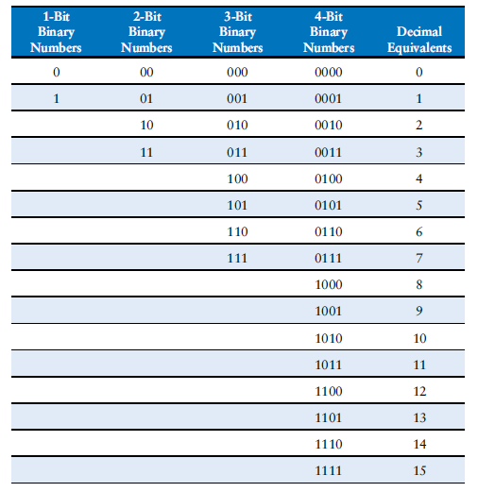

Slide 18
Practice
Convert the following binary numbers into decimal numbers:
Binary 1001 =
9
Binary 1111 =
15
Binary 0010 =
2
18

Slide 19
Hexadecimal Number System
Uses 16 symbols - Base 16 System
0-9, A, B, C, D, E, F
Decimal
1
9
10
15
16
Binary
0001
1001
1010
1111
10000
Hexadecimal
1
9
A
F
10
19

Slide 20
Decimal to Hexadecimal Conversion
Divide by 16 Process
Decimal #
47 ÷ 16 = 2 remainder 15
Divide-by-16 Process
Stops When
Quotient Reaches 0
2 ÷ 16 = 0 remainder 2
2
F
Digital Electronics by Parag P.
20

Slide 21
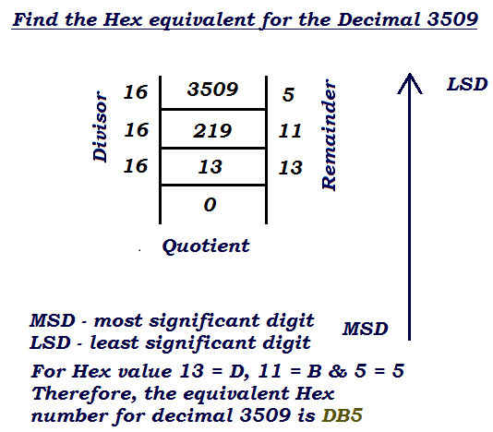

Slide 22
Hexadecimal to Decimal Conversion
Convert hexadecimal number 2DB to a decimal number
Place Value
256 16 1
16²
16¹
16⁰
Hexadecimal
2 D B
(256 x 2) (16 x 13) (1 x 11)
Decimal
512 + 208 + 11 = 731
22

Slide 23


Slide 24
Practice
Convert Hexadecimal number A6 to Binary
A6 =
1010 0110 (Binary)
Convert Hexadecimal number 16 to Decimal
16 =
22 (Decimal)
Convert Decimal 63 to Hexadecimal
63 =
3F (Hexadecimal)
24

Slide 25
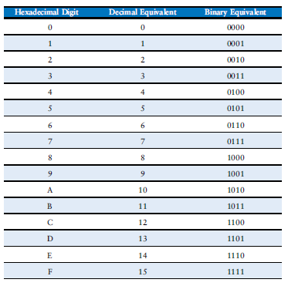

Slide 26
Octal Numbers
Uses 8 symbols - Base 8 System
0, 1, 2, 3, 4, 5, 6, 7
Decimal
1
6
7
8
9
Binary
001
110
111
001 000
001 001
Octal
1
6
7
10
11
26

Slide 27
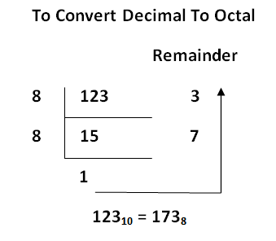
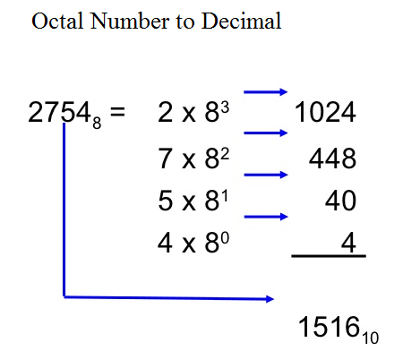
Octal Decimal conversion

Slide 28
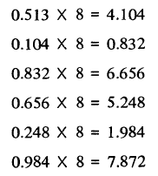

Decimal to Octal Conversion

Slide 29
Binary-Octal/Hexadecimal Conversion
Binary → Octal: Partition in groups of 3
(10 111 011 001 . 101 110)₂ = (2731.56)₈
Octal → Binary: reverse
(2731.56)₈ = (10 111 011 001 . 101 110)₂
Binary → Hexadecimal: Partition in groups of 4
(101 1101 1001 . 1011 1000)₂ = (5D9.B8)₁₆
Hexadecimal → Binary: reverse
(5D9.B8)₁₆ = (101 1101 1001 . 1011 1000)₂
29

Slide 30
Hexadecimal and Binary Conversions
Hexadecimal to Binary Conversion
Hexadecimal C 3
Binary 1100 0011
Binary to Hexadecimal Conversion
Binary 1110 1010
Hexadecimal E A
30

Slide 31


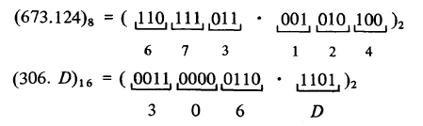
Binary-Octal/Hexadecimal Conversion

Slide 32
Base-R to Decimal Conversion
(1101.101)₂ = 1×2³ + 1×2² + 1×2⁰ + 1×2⁻¹ + 1×2⁻³ = 8 + 4 + 1 + 0.5 + 0.125
= (13.625)₁₀
(572.6)₈ = 5×8² + 7×8¹ + 2×8⁰ + 6×8⁻¹ = 320 + 56 + 2 + 0.75 = (378.75)₁₀
(2A.8)₁₆ = 2×16¹ + 10×16⁰ + 8×16⁻¹ = 32 + 10 + 0.5 = (42.5)₁₀
(341.24)₅ = 3×5² + 4×5¹ + 1×5⁰ + 2×5⁻¹ + 4×5⁻² = 75 + 20 + 1 + 0.4 + 0.16 = (96.56)₁₀
32

Slide 33
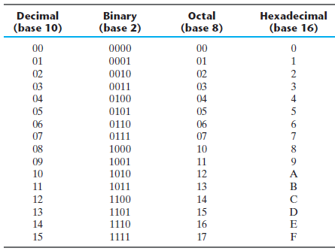
Numbers with Different Bases

Slide 34
Problems
1. Convert the following numbers with the indicated
bases to decimal:
(a) (4310)₅ (b) (198)₁₂
(c) (435)₈ (d) (345)₆
2. Convert the hexadecimal number 64CD to binary, and
then convert it from binary to octal.

Slide 35
3. Express the following numbers in decimal:
(a) (10110.0101)₂ (b) (16.5)₁₆
(c) (26.24)₈ (d) (DADA.B)₁₆
(e) (1010.1101)₂
4. Convert the following binary numbers to hexadecimal
and to decimal:
(a) 1.10010 (b) 110.010.
5. Convert the decimal number 431 to binary in two ways:
(a) convert directly to binary;
(b) convert first to hexadecimal and then from
hexadecimal to binary.
Which method is faster?

Slide 36
6. Determine the base of the numbers in each case for the
following operations to be correct:
(a)14/2 = 5 (b) 54/4 = 13 (c) 24+17=40
Solution:
The base of the numbers in each case for the following operations to be correct:
14/2 = 5;
Find decimal equivalent
14=1 x r¹ + 4 x r⁰ = r + 4
2=2 x r⁰=2
5=5 x r⁰=5
(4+r)/2=5
Solving this equation, we get r=6, base 6

Slide 37
54/4 = 13;
Find decimal equivalent
54=5 x r¹ + 4 x r⁰ = 5r + 4
4=4 x r⁰=4
13=1 x r¹ + 3 x r⁰ = r + 3
(5r+4)/4= r + 3
Solving this equation, we get r=8, base 8
24+17=40;
Find decimal equivalent
24=2 x r¹ + 4 x r⁰ = 2r + 4
17=1 x r¹ + 7 x r⁰ = r + 7
40=4 x r¹ + 0 x r⁰ = 4r + 0
(2r + 4) + (r + 7) = 4r
Solving this equation, we get r=11, base 11

